Slide 1
Farm hazards template
2026 Autumn Farm Assessment
Instructions:
Use this outline to build your presentation. Replace the bracketed text with your own research and images.

Slide 2
Slide 1: Title Slide
Title: Farm Safety Audit: [Insert Your Zone Name]
Presented by: [Student Names]
[Insert a photo of your zone at the KVC farm]

Slide 3
Slide 2: The Hazard Register
Create a table with the following columns:
Hazard: (General, Zone-Specific, and Bonus Tool)
Harm: (What could happen?)
Risk Level: (1-5)
Control: (How do we Eliminate or Minimise this?)

Slide 4
Slide 3: Tool Expert Deep Dive
The Tool: [Insert Name and Photo of Tool]
Safety Checklist: (3-5 points on how to use it safely)
Maintenance: (How do we clean or store it?)

Slide 5
Slide 4: Poster #1 - Warning Sign (each individual picks a hazard and makes a sign)
Display your high-contrast warning poster here. It should include:
Bold heading (e.g., DANGER or CAUTION).
Standard safety icons (Yellow triangles or Red circles).
Minimal text.

Slide 6
Script and contribution to the farm safety video
Slide 5: Instructional class video
As part of the overall assessment we are going to record a class safety video for next term’s class. We are working on a map as a class of where we will go as we record this video.
For example: the idea is if gumboots are important than record the information about this somewhere on the farm that is muddy.

Slide 7
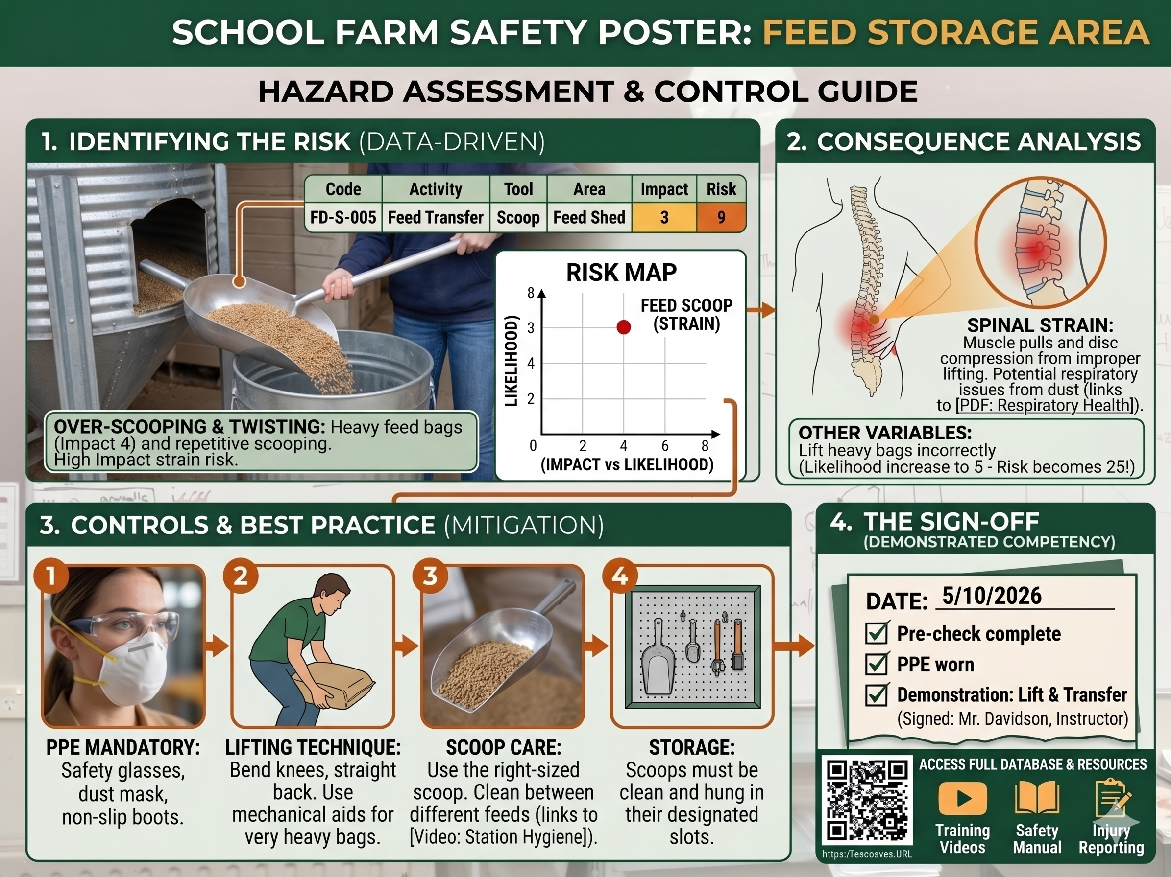
Slide 6: Poster #2 - Instructional Guide
Display your "How-To" guide for your Bonus Tool. It should include:
Step-by-step numbered instructions.
Clear diagrams or photos
of the tool in use.
PPE requirements
(e.g., "Must wear gloves").

